Slide 1
Chapter 8
Graphics programming
Notes:
setSize() sets the current size of the component. setPreferredSize() sets the preferred size of the component. It's this size that some layout managers (for example, BorderLayout) look at to determine how sizes should be set when laying out their components. Other layout managers -- GridLayout, for example -- ignore the preferred size and do their own thing.

Slide 2
Outline
Graphics programming
Event handling
Layout manager
Borders
Applets

Slide 3
Topics in this section
Introduction
Containers
JFrame, JPanel
Some Swing components
JLabel, JTextField, JButton
Notes:
Container: các loai container, cac ham useful

Slide 4
Graphical User Interfaces
Two aspects of programming:
Console applications: writing programs that take input from the keyboard, and then display the results on a console screen
GUI Applications: writing Java programs using a graphical user interface (GUI), that the user visually sees and interacts with

Slide 5
Main GUI Libraries in Java
AWT (Abstract Window Toolkit)
The original GUI library in Java 1.02
Easy building of simple-looking interfaces
GUIs depend on the platform program is running on
Swing
GUI library added to Java starting in Java 1.1
Professional looking GUIs that follow standard
GUIs with the same look and feel on multiple platforms
SWT (Standard Widget Toolkit)
GUI from the Eclipse foundation
Higher-performance professional looking GUIs
Notes:
When Java 1.0 was introduced, it contained a class library, which Sun called the Abstract Window Toolkit (AWT), for basic GUI programming
the reasons to choose Swing are overwhelming:
Swing has a rich and convenient set of user interface elements.
Swing has few dependencies on the underlying platform; it is therefore less prone to platform-specific bugs.
Swing gives a consistent user experience across platforms.
When a Java program with an AWT GUI executes on different Java
platforms, the program’s GUI components display differently on each platform.
The look and feel of AWT components depend on the platform the
program is running on. For example, an AWT button will look like a
Windows button when the program is run on a Windows platform. The
same button will look like a Macintosh button when the program is run
on a Macintosh platform.

Slide 6
Containers – Top level containers
Containers are the windows that can hold other windows or GUI components
JFrame, JPanel, Box,…
In a GUI, there is a main window, top-level containers, on which components are placed
Top-level containers
JFrame
JDialog
JApplet
JWindow
Notes:
The names of the Swing classes all begin with a capital J, like JButton.
For the most part, an AWT program can be converted to a Swing program
by adding a capital J to the class names used in the source code and
recompiling the code.

Slide 7
JFrame
JFrame container is used to create window in Swing program, it extends the Frame class
Some of its constructors are:
JFrame()
JFrame(String title)
Example:
JFrame f = new JFrame();
JFrame f = new JFrame(“My first window”);
Notes:
This Frame is not displayed on the screen, and it has an initial size of 0 by 0.
You need to give your Frame a size before displaying it, which can be done by
invoking one of the following five methods:
public void setSize()

Slide 8
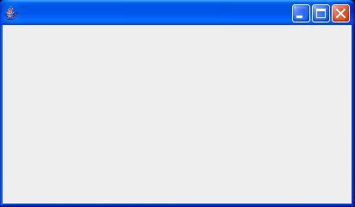
Create a JFrame: JFrameDemo1.java
Creating the JFrame object in main
Using a subclass of JFrame
import javax.swing.*;
public class JFrameDemo1 {
public static void main(String args[]) {
JFrame f = new JFrame();
f.setSize( 200, 200 );
f.setVisible( true );
}
}
import javax.swing.*;
public class JFrameDemo1 extends JFrame {
public JFrameDemo1() {
setSize( 200, 200 );
setVisible( true );
}
public static void main(String args[]) {
new JFrameDemo1();
}
}
Output
Notes:
setSize: By default, a frame has a rather useless size of 0 x 0 pixels. We define a subclass SimpleFrame whose constructor sets the size to 300 x 200 pixels. In the main method of the SimpleFrameTest class, we start out by constructing a SimpleFrame object.
setVisible: Simply constructing a frame does not automatically display it. Frames start their life invisible. That gives the programmer the chance to add components into the frame before showing it for the first time. To show the frame, the main method calls the setVisible method of the frame.
For this particular program, we want the program to exit. To select this behavior, we use the statement
frame.setDefaultCloseOperation(JFrame.EXIT_ON_CLOSE);

Slide 9
Create a JFrame: steps
There are basically three steps to create a JFrame window to appear on the screen:
Instantiate the JFrame object
Give the JFrame object a size using setSize, setBounds, or pack method
Make the JFrame appear on the screen by invoking: setVisible(true)
Coordinate Systems
(0, 0)
112
X
40
(112, 40)
Y
Notes:
As with Frame objects, this JFrame is initially not visible and has a size of 0
pixels by 0 pixels. You invoke one of the setSize(), setBounds(), or pack() methods
to give the JFrame a size and then invoke setVisible() to make it visible.

Slide 10
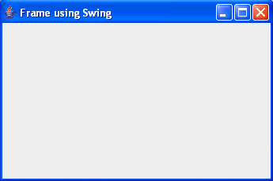
Create a JFrame: JFrameDemo2.java
JFrameDemo2.java
import javax.swing.*;
public class JFrameDemo2 extends JFrame {
public JFrameDemo2() {
super("Frame using Swing");
setBounds( 50,50, 400, 200 );
setVisible( true );
}
public static void main(String args[]) {
new JFrameDemo2();
}
}
Output
Add setDefaultCloseOperation(EXIT_ON_CLOSE); to exiting the Java application
Notes:
JFrames close automatically when you click on the Close button (unlike AWT Frames).
• However, closing the last JFrame does not result in your program exiting the Java application. To get this behavior,
call setDefaultCloseOperation(EXIT_ON_CLOSE).

Slide 11
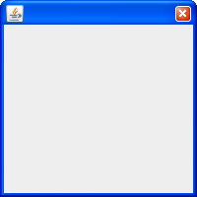
Create a JDialog: Example
JDialogDemo.java
Output
import javax.swing.*;
public class JDialogDemo extends JDialog {
public JDialogDemo() {
setSize(200, 200);
setVisible(true);
}
public static void main (String[] args) {
new JDialogDemo();
}
}

Slide 12
JPanel
A JPanel is used to group other components into rectangular regions
Usage:
Allocate JPanel, put other components in it, add to other container
Properties:
A panel can be nested within another panel
The default layout manager is FlowLayout
Constructors:
JPanel()
JPanel(LayoutManager lm)

Slide 13
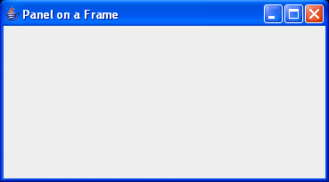
Example: JPanelDemo.java
Output
import javax.swing.*;
public class JPanelDemo extends JFrame {
public JPanelDemo() {
super("Panel on a Frame");
JPanel p = new JPanel();
add(p);
setSize(200,200);
setVisible(true);
}
public static void main(String args[]) { new JPanelDemo(); }
}

Slide 14
Useful Container methods
add
Add a component to the container
remove
Remove the component from the container
getComponents
Returns an array of components in the window
Used by layout managers
setLayout
Changes the layout manager associated with the window

Slide 15
Useful Container methods (cont.)
setVisible
Exposes (true) or hides (false) the component
setSize/setBounds/setLocation
getSize/getBounds/getLocation
Physical aspects (size and position) of the component
getBackground/setBackground
Change/lookup the default background color
To set color, using Color class in java.awt package
paint
Called whenever the user call repaint or when the component is obscured and reexposed
Notes:
Exposes bày ra
You define colors with the Color class in java.awt package
Color class offers predefined constants for the 13 standard colors
Example: Color.RED, Color.WHITE,…
You can specify a custom color by creating a Color object by its red, green, and blue components
Using Color constructor: Color(int red, int green, int blue): creates a color object
Example:
Color c = new Color(0,0,0); → black
Color c = new Color(255,255,255); → white

Slide 16
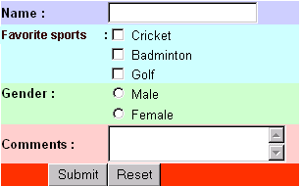
Some components
Label
Text field
Checkbox
Radio button
Text Area
Button

Slide 17
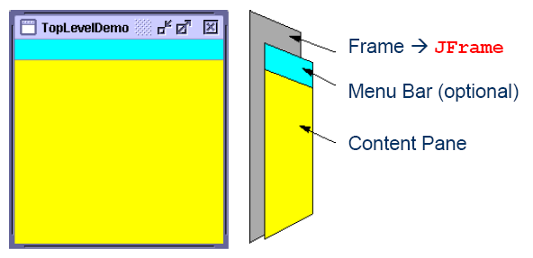
A Java screen layout
Notes:
JFrame có nhiều tầng chồng lên nhau, tầng Content nằm trong cùng cho nên các đối tượng chính (nút, nhãn, list) add vô đây, các tầng khác thì chứa các đối tượng khác.

Slide 18
Content Pane
Components have to be added to the content pane, not directly to the JFrame object
Up to JDK 1.4, we get content pane and use add method of that containner to add components
As of JDK 5.0, we simply use the add method of JFrame
JFrame f = new JFrame();
Component c = . . . ;
f.getContentPane().add(c);
JFrame f = new JFrame();
Component c = . . . ;
f.add(c);

Slide 19
How to add a component to a container?
To create component on a GUI, the steps to be followed are:
Create the component
Set its attributes (size, color, font) - option
Add it to the container
Example: add a button to a frame
// Create the button
JButton btn;
btn = new JButton ("OK");
// Add the button to the frame
add(btn);
JButton btn;
add(btn=new JButton("OK");

Slide 20
JLabel
Purpose: used to display information
Constructors:
JLabel()
Creates an empty label
JLabel(String labeltext)
Creates a label with a given text
JLabel(String labeltext, int alignment)
Creates a label with given alignment where alignment can be LEFT, RIGHT, CENTER, LEADING or TRAILING. These are constants and are defined in SwingConstant interface

Slide 21
JLabel (cont.)
Constructors (cont.):
JLabel (Icon img)
Only Icon will be used for label
JLabel (String str, Icon img, int align)
Some methods:
String getText()
void setText(String text)
Gets or sets the text displayed on the label
Font getFont()
void setFont(Font font)
Gets or sets the current font of the label

Slide 22
Using special fonts for text
To draw characters in a font, you must first create an object of the class Font
Constructor:
Font(String font_name, int font_style, int font_size)
Example:
Font fo = new Font ("Times New Roman", Font.BOLD, 14);
Arial
Tahoma
Times New Roman
Helvetica
SansSerif
Serif
….
Font.PLAIN
Font.BOLD
Font.ITALIC
Font.BOLD + Font.ITALIC

Slide 23
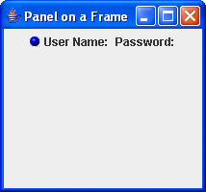
Example: JLabelDemo.java
import javax.swing.*;
public class JLabelDemo extends JFrame {
public JLabelDemo() {
super("Panel on a Frame");
JLabel l1, l2;
l1 = new JLabel("User Name: ", new ImageIcon("blue-ball.gif"), SwingConstants.CENTER);
l2 = new JLabel("Password: ");
JPanel jp = new JPanel();
jp.add(l1);
jp.add(l2);
add(jp);
setSize(400, 400);
setVisible(true);
}
public static void main(String args[]){
new JLabelDemo();
}
}

Slide 24
JTextField
Purpose
to input text
display information
The width of JTextField: is measured by column
The column width that you set in the JTextField constructor is not an upper limit on the number of characters the user can enter

Slide 25
JTextField - Constructors
JTextField()
creates an empty textfield with 1 columns
TextField(String s)
creates a new textfield with the given string
JTextField(int cols)
creates an empty textfield with given number of columns
JTextField(String text, int cols)
creates a new textfield with given string and given number of columns
Example:
JTextField mmText = new JTextField (10);
JTextField txtName = new JTextField (“Hello”, 10);

Slide 26
JTextField - Methods
int getColumns()
void setColumns(int cols)
gets or sets the number of columns for text field
String getText()
void setText(String t)
gets or sets the text in text field
int getHorizontalAlignment()
void setHorizontalAlignment(int alignment)
gets or sets the horizontal alignment for text field
void setFont(Font font)
sets the font for this text field
void setEditable(boolean b)
determines whether the user can edit the content

Slide 27
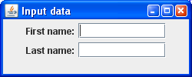
Example: JTextFieldDemo.java
import javax.swing.*;
public class JTextFieldDemo extends JFrame {
JTextField textFN, textLN;
public JTextFieldDemo() {
super("Input data");
JLabel l1, l2;
JPanel jp = new JPanel();
jp.add(l1 = new JLabel("First name:"));
jp.add (textFN=new JTextField (10));
jp.add(l2 = new JLabel("Last name:"));
jp.add (textLN=new JTextField (10));
add(jp);
setDefaultCloseOperation(EXIT_ON_CLOSE);
setSize(250, 100);
setVisible(true);
}
public static void main(String[] args) { new JTextFieldDemo(); }
}

Slide 28
JButton
JButton object consists of a text label and/or image icon
Constructors:
JButton()
JButton(Icon icon)
JButton(String text)
JButton(String text, Icon icon)
Creates a button with the specified text or/and icon
When the user click the button, JButton generates an Action event

Slide 29
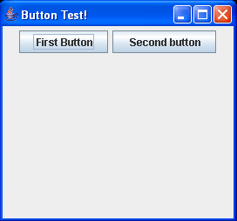
Example 1: JButtonDemo1.java
import javax.swing.*;
public class JButtonDemo1 extends JFrame {
JButton btn1, btn2;
public JButtonDemo1() {
super("Button Test!");
JPanel p = new JPanel();
// Create the two buttons
btn1 = new JButton ("First Button");
btn2 = new JButton ("Second button");
// Add the two buttons to the panel
p.add(btn1);
p.add(btn2);
// Add panel to the frame
add(p);
setSize(300,300);
setVisible(true);
}
public static void main(String[] args) { new JButtonDemo1(); }
}
Notes:
Try to add 2 buttons to JFrame, it’s fun.
Đối với layout là FlowLayout, để kích thước nút b1 = b2, dùng: b1.setPreferredSize(b2.getPreferredSize());
Đối với layout là Box, để kích thước nút b1 = b2, dùng: b1.setMaximumSize(b2.getPreferredSize());

Slide 30
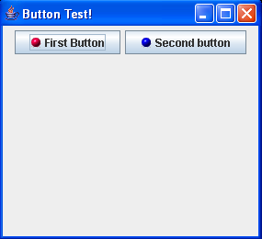
Example 2: JButtonDemo2.java
import java.awt.*;
import javax.swing.*;
public class JButtonDemo2 extends JFrame {
JButton btn1, btn2;
public JButtonDemo2() {
super("Button Test!");
// Create the two buttons
btn1 = new JButton ("First Button", new ImageIcon("red-ball.gif"));
btn2 = new JButton ("Second button", new ImageIcon("blue-ball.gif"));
JPanel panel = new JPanel();
// Add the two buttons to the panel
panel.add(btn1);
panel.add(btn2);
// Add panel to the frame
add(panel);
setSize(300,300);
setVisible(true);
}
public static void main(String[] args) { new JButtonDemo2(); }
}

Slide 31
Outline
Graphics programming
Event handling
Layout manager
Borders
Applets

Slide 32
Event
An event is an object that represents some activity to which we may want to respond, example:
the mouse is moved
the mouse is dragged
a mouse button is clicked
a graphical button is clicked
a keyboard key is pressed
a timer expires
Events often correspond to user actions, but not always
Each type of event belongs to an Event class

Slide 33
Some Event classes (see more p560)
Lớp sự kiện | Mô tả
ActionEvent | Phát sinh khi click vào một nút hay click chọn menu, hoặc double-click vào một mục trong một danh sách
FocusEvent | Phát sinh khi một đối tượng bị mất hay nhận focus từ bàn phím
ItemEvent | Phát sinh khi một mục menu được chọn hay bỏ chọn; hay khi click vào checkbox hoặc click chọn một mục trong danh sách
WindowEvent | Phát sinh khi một cửa sổ được kích hoạt, được đóng, được mở hay thoát
TextEvent | Phát sinh khi nội dung trong ô nhập liệu bị thay đổi
MouseEvent | Phát sinh khi chuột di chuyển, hoặc được click, được kéo hay thả ra
KeyEvent | Phát sinh khi nhấn bàn phím

Slide 34
Event handling
Components generate events, and listeners handle the events when they occur
A listener object "waits" for an event to occur and responds accordingly
Event
Component
Listener
A component
may generate an event
A listener
responds to the event
When the event occurs, the appropriate method of the listener is called with an object that describes the event is passed
Notes:
Objects in the Java event handling model:
components (labels, buttons, text fields, menus, …)
events
listeners

Slide 35
General process
Determine what type of listener is of interest
ActionListener, ItemListener, KeyListener, MouseListener, WindowListener,…
If you have an Event class, you will have a listener
Define a class of that type
Implement the interface
If you implement a listener, you must write all methods in that listener
Register an object of your listener class with the component
component.addXxxListener(eventListenerObject);
E.g., addKeyListener, addMouseListener
Notes:
Extend class (KeyAdapter, MouseAdapter, etc.)
How to determine the type of listener?
Each type of event has an event class and a corresponding event listener interface
For example
if you want to listen to an ActionEvent, you write a class that implements the ActionListener interface
if you want to listen for a WindowEvent, you write a class that implements WindowListener interface
→ determine listener interface: replace Event with Listener
What methods will be written?

Slide 36
Review of Interfaces: Syntax
Shape interface
public interface Shape {
public double getArea(); // No body, just specification
}
Circle class
public class Circle implements Shape {
public double getArea() {
//some real code
}
}

Slide 37
Example: ActionListener interface
ActionListener interface
public interface ActionListener {
public void actionPerformed(ActionEvent event)
}
ButtonHandlingDemo class
public class ButtonHandlingDemo implements ActionListener {
public void actionPerformed(ActionEvent event){
…
}
}

Slide 38
Example: MouseListener interface
public interface MouseListener {
public void mouseClicked(MouseEvent e);
public void mousePressed(MouseEvent e);
public void mouseReleased(MouseEvent e);
public void mouseEntered(MouseEvent e);
public void mouseExited(MouseEvent e);
}
public class ButtonHandlingDemo implements MouseListener {
public void mouseClicked(MouseEvent e) { …}
public void mousePressed(MouseEvent e) {… }
public void mouseReleased(MouseEvent e) { …}
public void mouseEntered(MouseEvent e) {… }
public void mouseExited(MouseEvent e) { …}
}

Slide 39
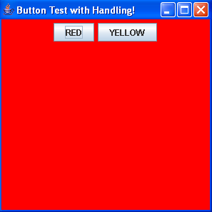
The ways to handle event
Event-handling options
Handling events with separate listeners
Handling events by implementing interfaces in frame
Handling events with named inner classes
Handling events with anonymous inner classes
Notes:
anonymous vô danh

Slide 40
Handling events with separate listeners
import java.awt.*;
import java.awt.event.*;
import javax.swing.*;
public class HandlingButtonDemo11
extends JFrame {
JButton btn1, btn2;
JPanel panel;
public HandlingButtonDemo1 () {
super("Button Test with Handling!");
panel = new JPanel();
panel.add(btn1 = new JButton ("RED"));
panel.add(btn2 = new JButton ("YELLOW"));
add(panel);
btn1.addActionListener(new HandlingButton1(panel));
setSize(300,300);
setVisible(true);
}
public static void main(String[] args) { new HandlingButtonDemo1(); }
}
class HandlingButton1 implements ActionListener {
JPanel panel;
public HandlingButton1(JPanel p) {
panel = p;
}
public void actionPerformed(ActionEvent e) {
panel.setBackground(Color.red);
}
}
How to do with YELLOW button?
Notes:
With this scenario, each time a user clicks on any of the buttons on the panel, the associated listener object then receives an ActionEvent that indicates a button click. In our sample program, the listener object will then change the background color of the panel.
The source of the event (event source)
The component is the source of the event
A listener of an event (event listener)
Any class that implements listener interface and registers itself with the source of the event
An event listener interface

Slide 41
Handling events by implementing interfaces
import java.awt.*;
import javax.swing.*;
import java.awt.event.*;
public class HandlingButtonDemo21extends JFrame implements ActionListener {
JButton btn1, btn2;
JPanel panel;
public HandlingButtonDemo2() {
super("Button Test with Handling!");
panel = new JPanel();
panel.add(btn1=new JButton ("RED"));
panel.add(btn1=new JButton ("YELLOW"));
add(panel);
btn1.addActionListener(this);
setSize(300,300);
setVisible(true);
}
How to do with YELLOW button?
public static void main(String[] args) {
new HandlingButtonDemo2();
}
}
public void actionPerformed(ActionEvent e)
{
panel.setBackground(Color.red);
}
Notes:
With this scenario, each time a user clicks on any of the buttons on the panel, the associated listener object then receives an ActionEvent that indicates a button click. In our sample program, the listener object will then change the background color of the panel.

Slide 42
Handling events with named inner classes
import …
public class HandlingButtonDemo31extends JFrame {
JButton btn1, btn2;
JPanel panel;
public HandlingButtonDemo3 () {
…
btn1.addActionListener(new HandlingButton());
setSize(300,300);
setVisible(true);
}
public static void main(String[] args) { new HandlingButtonDemo3(); }
}
How to do with YELLOW button?
private class HandlingButton implements ActionListener {
public void actionPerformed( ActionEvent e ) {
panel.setBackground(Color.red);
}
}

Slide 43
Handling events with anonymous inner classes
import …
public class HandlingButtonDemo41extends JFrame {
JButton btn1, btn2; JPanel panel;
public HandlingButtonDemo4() {
…
btn1.addActionListener( new ActionListener() {
public void actionPerformed(ActionEvent e) {
panel.setBackground(Color.red);
}
} );
btn2.addActionListener( new ActionListener() {
public void actionPerformed(ActionEvent e) {
panel.setBackground(Color.yellow);
}
} );
setSize(300,300);
setVisible(true);
}
public static void main(String[] args) {
new HandlingButtonDemo4();
}
}

Slide 44
Determining Event Sources
One listener object can "listen" to many different components
The source of the event can be determined by using the getSource method of the event passed to the listener, it returns a reference to the component that generated the event
Object source = e.getSource();
if (source.equals(component1) )
// do something
else if (source.equals(component2))
// do something
…

Slide 45
HandlingButtonDemo2.java
import …
public class HandlingButtonDemo21extends JFrame implements ActionListener {
JButton btn1, btn2;
JPanel panel;
public HandlingButtonDemo2 () {
super("Button Test with Handling!");
panel = new JPanel();
btn1 = new JButton(“RED");
btn2 = new JButton(“YELLOW");
btn1.addActionListener(this);
btn2.addActionListener(this);
panel.add(btn1);
panel.add(btn2);
add(panel);
setSize(300,300);
setVisible(true);
}
public void actionPerformed(ActionEvent e)
{
Object source = e.getSource();
if (source .equals(btn1) )
panel.setBackground(Color.red);
else if (source.equals(btn2))
panel.setBackground(Color.yellow);
}
public static void main(String[] args) {
new HandlingButtonDemo2();
}
}
Notes:
With this scenario, each time a user clicks on any of the buttons on the panel, the associated listener object then receives an ActionEvent that indicates a button click. In our sample program, the listener object will then change the background color of the panel.

Slide 46
Outline
Introduction to Graphics programming
Event handling
Layout manager
Borders
Applets
How Java arranges components?

Slide 47
Topics in this section
Layout Manager
Standard layout managers
FlowLayout, BorderLayout, GridLayout, BoxLayout
Positioning components manually
Strategies for using layout managers effectively
Originals of Slides and Source Code for Examples:
http://courses.coreservlets.com/Course-Materials/java5.html

Slide 48
Layout Manager
A layout manager is an object which assigned to a container to determines the way that components are arranged in it
There are some predefined layout managers
Each layout manager has its own particular rules
FlowLayout
BorderLayout
CardLayout
GridLayout
GridBagLayout
Defined in the AWT
BoxLayout
OverlayLayout
Defined in Swing
Notes:
Khung chứa container nhận các đối tượng từ bên ngoài đưa vào và nó phải biết làm thế nào để tổ chức sắp xếp “chỗ ở” cho các đối tượng đó. Mỗi đối tượng khung chứa đều có một bộ quản lý chịu trách nhiệm thực hiện công việc đấy đó là bộ quản lý trình bày (Layout Manager).
Note:
FlowLayout, BorderLayout,
GridLayout, BoxLayout.

Slide 49
Default LM – Change LM
Every container has a default layout manager
A Panel has FlowLayout by default
A JFrame has BorderLayout by default
To change layout manager of a container, we use setLayout method of that container:
Example:
JPanel panel = new JPanel();
panel.setLayout( new BorderLayout() );
void setLayout(LayoutManager m)

Slide 50
FlowLayout
Default layout for JPanel and JApplet
Behavior
Places components in rows left to right, top to bottom
Rows are centered by default
Components are displayed in the order they are added to the container
Resizes components to their preferred size
When the frame is resized, the components are reorganized automatically
Notes:
Đối với một container trình bày theo kiểu FlowLayout thì:
Các component gắn vào được sắp xếp theo thứ tự từ trái sang phải và từ trên xuống dưới.
Các component có kích thước như mong muốn.
Nếu chiều rộng của Container không đủ chỗ cho các component thì chúng tự động tạo ra một dòng mới.
FlowLayout thường được dùng để để sắp xếp các button trong 1 panel.
Chúng ta có thể điều chỉnh khoảng cách giữa các component.

Slide 51
FlowLayout – Constructors
public FlowLayout()
Centers each row and keeps 5 pixels between entries in a row and between rows
public FlowLayout(int align)
Same 5 pixels spacing, but changes the alignment of the rows to FlowLayout.LEFT, FlowLayout.RIGHT, FlowLayout.CENTER
public FlowLayout(int align, int hgap, int vgap)
Specify the alignment as well as the horizontal and vertical spacing between components (in pixels)

Slide 52
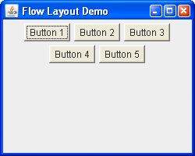
Example: FlowLayoutDemo.java
import javax.swing.*;
public class FlowLayoutDemo extends JFrame {
public FlowLayoutDemo () {
super("Flow Layout Demo");
JPanel panel = new JPanel();
// panel.setLayout (new FlowLayout()); [Default]
for(int i=1; i<6; i++) {
panel.add(new Button("Button " + i));
}
add(panel);
setDefaultCloseOperation(EXIT_ON_CLOSE);
setSize(250,200);
setVisible(true);
}
public static void main(String[] s) { new FlowLayoutDemo(); }
}

Slide 53
BorderLayout
Default for JFrame, JDialog, JApplet
Behavior
Divides the container into five regions
Allowing only one object to be added to each region
Is allowing a maximum of five components too restrictive? Why not?
NORTH
WEST
CENTER
EAST
SOUTH
Notes:
– NORTH and SOUTH respect the preferred height of the component
– EAST and WEST respect the preferred width of the component
– CENTER is given the remaining space
You do not need to add a component to each region
If nothing is added to the outer areas, they take up no space and other areas expand to fill the void
If you do not specify a region each new component defaults to the centre of the Frame
Restrictive hạn chế

Slide 54
BorderLayout (cont.)
Constructors
BorderLayout()
Border layout with no gaps between components
BorderLayout(int hGap, int vGap)
Border layout with the specified horizontal and vertical gap between regions (in pixels)
Adding components
add(component, BorderLayout.REGION)
Always specify the region in which to add the component
CENTER is the default, but specify it explicitly to avoid confusion with other layout managers

Slide 55
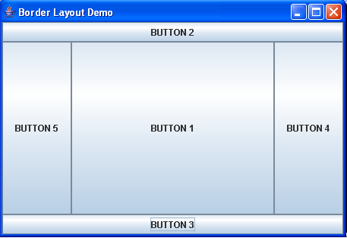
Example: BorderLayoutDemo.java
import java.awt.*;
import javax.swing.*;
public class BorderLayoutDemo extends JFrame {
public BorderLayoutDemo() {
super("Border Layout Demo");
add (new JButton ("BUTTON 1"), BorderLayout.CENTER);
add (new JButton ("BUTTON 2"), BorderLayout.NORTH);
add (new JButton ("BUTTON 3"), BorderLayout.SOUTH);
add (new JButton ("BUTTON 4"), BorderLayout.EAST);
add (new JButton ("BUTTON 5"), BorderLayout.WEST);
setDefaultCloseOperation(EXIT_ON_CLOSE);
this.setSize(400,300);
this.setVisible(true);
}
public static void main(String[] s) { new BorderLayoutDemo(); }
}

Slide 56
GridLayout
Behavior
Divides container into equal-sized rectangles based upon the number of rows and columns specified
Objects placed into cells left-to-right, top-to-bottom, based on the order added to the container
In each cell of the grid, only one object can be added
Ignores the preferred size of the component; each component is resized to fit into its grid cell
Too few components results in blank cells
Too many components results in extra columns

Slide 57
GridLayout – Constructors
public GridLayout()
Creates a single row with one column allocated per component
public GridLayout(int rows, int cols)
Divides the window into the specified number of rows and columns
Either rows or cols (but not both) can be zero
public GridLayout(int rows, int cols, int hgap, int vgap)
Uses the specified gaps between cells
Notes:
– GridLayout() Creates a GridLayout object with one row and any number of columns

Slide 58
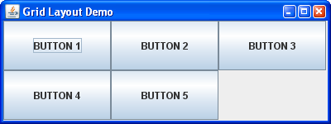
Example: GridLayoutDemo.java
import java.awt.*;
import javax.swing.*;
public class GridLayoutDemo extends JFrame {
public GridLayoutDemo() {
super("Grid Layout Demo");
setLayout (new GridLayout(2,3)); // 2 rows, 3 cols
add(new JButton ("BUTTON 1"));
add(new JButton ("BUTTON 2"));
add(new JButton ("BUTTON 3"));
add(new JButton ("BUTTON 4"));
add(new JButton ("BUTTON 5"));
setDefaultCloseOperation(EXIT_ON_CLOSE);
setSize(400,150);
setVisible(true);
}
public static void main(String[] s) { new GridLayoutDemo(); }
}

Slide 59
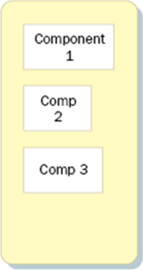
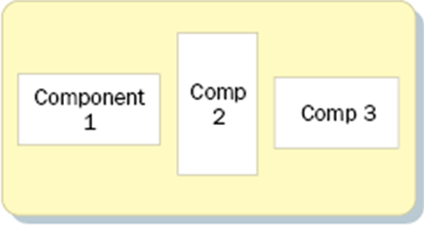
BoxLayout
Behavior
Organizes components in horizontal or vertical rows and control the sizes and gaps
Do not wrap as they do with FlowLayout
No space between the components in a BoxLayout
It tries to grow all components vertically to its height
In a box, when there are different component alignments, they are aligned to the center
The simplest way to use BoxLayout is just start with a Box container
Notes:
The components do not wrap as they do with FlowLayout
When there are different component alignments, they are aligned to the center of the container. So, for left alignment, that component will have its left edge on the invisible center line of the container. For right alignment, it is the right edge

Slide 60
BoxLayout
Usage
Create a Box object, place your components in the Box, and place the Box into your container
To create a Box object
Box box = new Box(BoxLayout.X_AXIS);
Box box = Box.createHorizontalBox();
The objects are displayed horizontally from left to right
Box box = new Box(BoxLayout.Y_AXIS);
Box box = Box.createVerticalBox();
The objects are displayed vertically from top to bottom
Notes:
public BoxLayout(Container target, int axis). Creates a new BoxLayout
manager for the specified target and given axis.
The possible values of axis are as follows:
BoxLayout.X_AXIS. The components are displayed horizontally from
left to right.
BoxLayout.Y_AXIS. The components are displayed vertically from top to
bottom.
BoxLayout.LINE_AXIS. Similar to X_AXIS, the components are laid out
horizontally. The order they are displayed is different, depending on the
container’s ComponentOrientation property, which allows components
to be displayed from right to left or from left to right.
BoxLayout.PAGE_AXIS. Components are laid out like words on a page
based on the container’s ComponentOrientation property, which allows
the components to be laid out from right to left, from left to right, from
top to bottom, or from bottom to top.

Slide 61
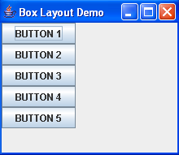
Example 1: BoxLayoutDemo.java
import java.awt.*;
import javax.swing.*;
public class BoxLayoutDemo extends JFrame {
JButton b1 , b2, b3, b4, b5;
public BoxLayoutDemo() {
super("Box Layout Demo");
//Create a Box with a vertical axis
Box box = Box.createVerticalBox();
//Add some components to the Box.
box.add( b1 = new JButton("BUTTON 1") );
box.add( b2 = new JButton("BUTTON 2") );
box.add( b3 = new JButton("BUTTON 3") );
box.add( b4 = new JButton("BUTTON 4") );
box.add( b5 = new JButton("BUTTON 5") );
//Add the Box to the content pane of this JFrame
add(box);
setSize(200, 200);
setVisible(true);
}
public static void main(String [] args){ new BoxLayoutDemo(); }
}

Slide 62
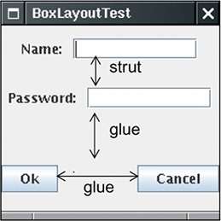
Fillers in BoxLayout
To space the components out, you add invisible fillers
Strut
Simply adds some space between components
Glue
Separates components as much as possible
Rigid area
Fixed-size rectangular space between two components
Notes:
Fillers chất độn

Slide 63
Strut
Create a space with fixed width, fixed height
static Component createHorizontalStrut (int width)
static Component createVerticalStrut (int height)
For example, add 10 pixels of space between two components in a horizontal box:
Box box = Box.createHorizontalBox();
box.add(label);
box.add(Box.createHorizontalStrut(10));
box.add(textField);

Slide 64


Glue
To create an invisible component that can expand infinitely horizontally, vertically, or in both directions:
static Component createHorizontalGlue()
static Component createVerticalGlue()
static Component createGlue()
For example:
Box box = Box.createHorizontalBox();
box.add(firstComponent);
box.add(Box.createHorizontalGlue());
box.add(secondComponent);

Slide 65


Rigid area
Create a rigid area with fixed width and height:
static Component createRigidArea(Dimension d)
For example, to put 5 pixels between two components in a vertical box
container.add(firstComponent);
container.add(Box.createRigidArea(new Dimension(5, 0)));
container.add(secondComponent);

Slide 66
Example 2: BoxLayoutTest.java
super("BoxLayout Test");
Box hbox1 = Box.createHorizontalBox();
hbox1.add(new JLabel("Name:"));
hbox1.add(Box.createHorizontalStrut(10));
hbox1.add(textField1 = new JTextField(10));
Box hbox2 = Box.createHorizontalBox();
hbox2.add(new JLabel("Password:"));
hbox2.add(Box.createHorizontalStrut(10));
hbox2.add(textField2 = new JTextField(10));
Box hbox3 = Box.createHorizontalBox();
hbox3.add(button1 = new JButton("Ok"));
hbox3.add(Box.createGlue());
hbox3.add(button2 = new JButton("Cancel"));
Notes:
textField1.setMaximumSize(textField1.getPreferredSize());
textField2.setMaximumSize(textField2.getPreferredSize());

Slide 67
Example 2: BoxLayoutTest.java (cont.)
// add the three horizontal boxes inside a vertical box
Box vbox = Box.createVerticalBox();
vbox.add(hbox1);
vbox.add(hbox2);
vbox.add(Box.createGlue());
vbox.add(hbox3);
add(vbox, BorderLayout.CENTER);
setDefaultCloseOperation(JFrame.EXIT_ON_CLOSE);
setSize(200, 100);
setVisible(true);

Slide 68
Strategies for using Layout Managers
Disabling the Layout Manager
Using Layout Managers effectively
Use nested containers
Try dividing the design into sections
Let each section be a panel with its own layout manager
Turn off the layout manager for some containers
Adjust the empty space around components
Change the space allocated by the layout manager
Override insets in the Container
Use a Box as an invisible spacer

Slide 69
Disabling the Layout Manager
If the layout is set to null, then components must be sized and positioned by hand
Positioning components
component.setSize(width, height)
component.setLocation(left, top)
or
component.setBounds(left, top, width, height)

Slide 70
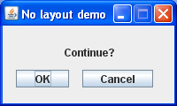
Example: NoLayout.java
import java.awt.*;
import javax.swing.*;
public class NoLayout extends JFrame {
JButton ok, cancel;
public NoLayout () {
super("No layout demo");
setLayout(null);
JLabel message = new JLabel(“Continue?”);
message.setBounds(70, 20, 125, 20);
ok = new JButton("OK");
ok.setBounds(15,50, 60, 20);
cancel = new JButton(“Cancel”);
cancel.setBounds(90, 50, 80, 20);
add(message); add(ok); add(cancel);
setSize(200,120);
setResizable(false);
setVisible(true);
}
public static void main(String [] args){ new NoLayout (); }
}

Slide 71
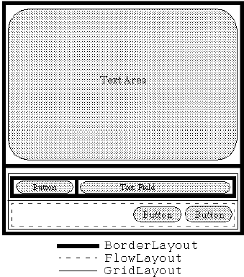
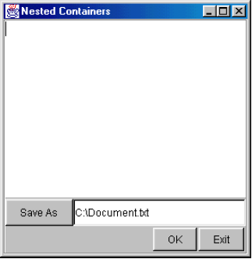
Nested Containers: Example

Slide 72
Example: NestedLayout
public NestedLayout() {
super("Nested Layout Demo");
setLayout(new BorderLayout(2,2));
JTextArea textArea = new JTextArea(12,40); // 12 rows, 40 cols
JButton bSaveAs = new JButton("Save As");
JTextField fileField = new JTextField("C:\\Document.txt");
JButton bOk = new JButton("OK");
JButton bExit = new JButton("Exit");
add(textArea, BorderLayout.CENTER);
// Set up buttons and textfield in bottom panel
JPanel bottomPanel = new JPanel();
bottomPanel.setLayout(new GridLayout(2,1));

Slide 73
Example: NestedLayout (cont.)
JPanel subPanel1 = new JPanel();
JPanel subPanel2 = new JPanel();
subPanel1.setLayout(new BorderLayout());
subPanel2.setLayout (new FlowLayout(FlowLayout.RIGHT, 2, 2));
subPanel1.add(bSaveAs, BorderLayout.WEST);
subPanel1.add(fileField, BorderLayout.CENTER);
subPanel2.add(bOk);
subPanel2.add(bExit);
bottomPanel.add(subPanel1);
bottomPanel.add(subPanel2);
add(bottomPanel, BorderLayout.SOUTH);
pack();
setVisible(true);
}

Slide 74
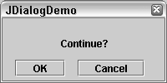
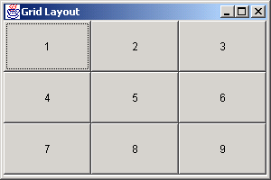
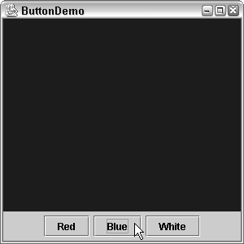
Example
Notes:
ConfirmFrame.java
ChangePanelColor.java

Slide 75
Turn off the layout manager for some containers: Example
Suppose that you wanted to arrange a column of buttons (on the left) that take exactly 40% of the width of the container
setLayout(null);
int width1 = getSize().width*4/10;,
int height = getSize().height;
Panel buttonPanel = new Panel();
buttonPanel.setBounds(0, 0, width1, height);
buttonPanel.setLayout(new GridLayout(6, 1));
buttonPanel.add(new Label("Buttons", Label.CENTER));
buttonPanel.add(new Button("Button One"));
...
buttonPanel.add(new Button("Button Five"));
add(buttonPanel);
Panel everythingElse = new Panel();
int width2 = getSize().width - width1,
everythingElse.setBounds(width1+1, 0, width2, height);

Slide 76
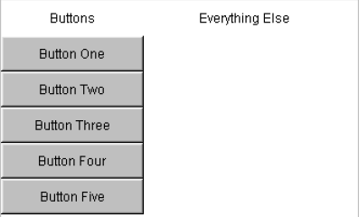
Turn off the layout manager for some containers: Result

Slide 77
Adjust the empty space around components
Change the space allocated by the layout manager
Most LayoutManagers accept a horizontal spacing (hGap) and vertical spacing (vGap) argument
Use a Box as an invisible spacer
For Swing layouts, add a Box as an invisible spacer to improve positioning of components

Slide 78
Outline
Graphics programming
Event handling
Layout manager
Borders
Applets

Slide 79
Borders
Purpose
Create border to any component that extends JComponent (p.424)
With JPanel, group components visually
Usage
Create a Border object by calling BorderFactory.createXxxBorder(…)
To apply a border object to a component, using the component’s setBorder method
Example
label.setBorder(BorderFactory.createLineBorder(Color.red));
Notes:
A border can be put around any Swing component to define how the edges of the component should be drawn

Slide 80
Static methods in BorderFactory
createEmptyBorder(int top, int left, int bottom, int right)
Simply adds space (margins) around the component
createLineBorder(Color color)
createLineBorder(Color color, int thickness)
Creates a solid-color border
createTitledBorder(String title)
createTitledBorder(Border border, String title)
The border is an etched line unless you explicitly provide a border style in second constructor
createEtchedBorder()
createEtchedBorder(Color highlight, Color shadow)
Creates a etched line without the label

Slide 81
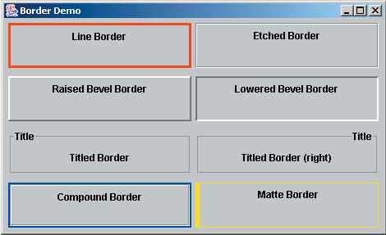
Example: BorderDemo.java

Slide 82
Outline
Graphics programming
Event handling
Layout manager
Borders
Applets

Slide 83
Applets
A Java applet is a program that is intended to transported over the Web and executed using a web browser
An applet doesn't have a main method
The paint method is executed automatically and is used to draw the applet’s contents
public void paint (Graphics g)
A Graphics object defines a graphics context on which we can draw shapes and text

Slide 84
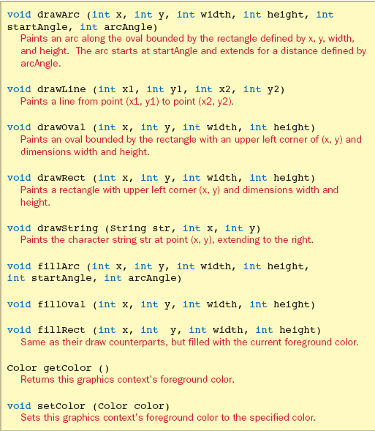
Some methods of the Graphics class

Slide 85
Applets
The class that defines an applet extends the Applet class
Applet classes must also be declared as public
An applet is embedded into an HTML file using a tag that references the bytecode file of the applet
See Einstein.java (page 97)
Notes:
The bytecode version of the program is transported across the web and executed by a Java interpreter that is part of the browser

Slide 86
Einstein.java
import java.applet.Applet;
import java.awt.*;
public class Einstein extends Applet
{
public void paint (Graphics g)
{
g.drawRect (50, 50, 40, 40); // square
g.drawRect (60, 80, 225, 30); // rectangle
g.drawOval (75, 65, 20, 20); // circle
g.drawLine (35, 60, 100, 120); // line
g.drawString ("Out of clutter, find simplicity.", 110, 70);
g.drawString ("-- Albert Einstein", 130, 100);
}
}

Slide 87
The HTML applet Tag
<html>
<head>
<title>The Einstein Applet</title>
</head>
<body>
<applet code="Einstein.class" width=350 height=175>
</applet>
</body>
</html>

Slide 88
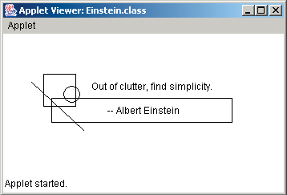
Output

